Slide 1
Visually similar pictures recommender
“What if you could choose your next destination based on pictures you like?”
Presented by Kevin THAI

Slide 2


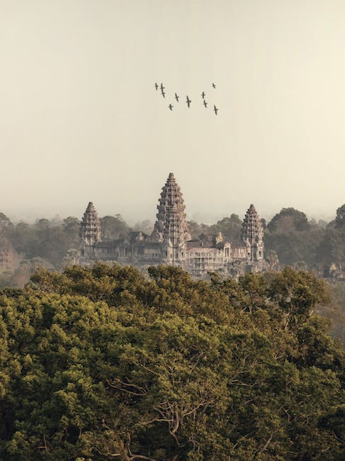
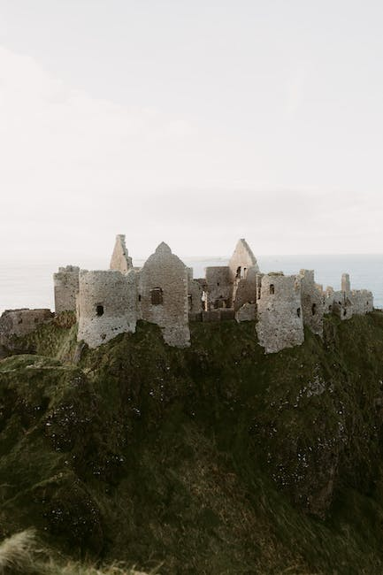

Running short of traveling ideas ? We have the solution!
Input
Output

Slide 3

Today’s journey
01
02
03
Prepare our lugage
Get our VISA
Travel
Data Collection
Data Cleaning
Exporting to MySQL
Data Exploratory Analysis with SQL and Python
Machine Learning
Live Demo

Slide 4
01
Preparing our lugage
“We are building our dataset to train the model. It needs to be clean and consistent.”

Slide 5
From Data Collection to MySQL database export
CHOOSE YOUR LUGAGE SIZE
Data Collection using Pexels API
DOUBLE-CHECK
Data Cleaning
LOCK IT
Exporting 4 entities/tables in to MySQL database

Slide 6
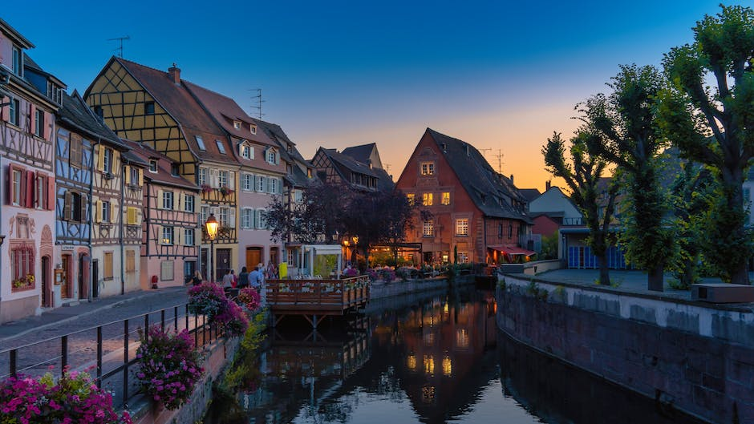
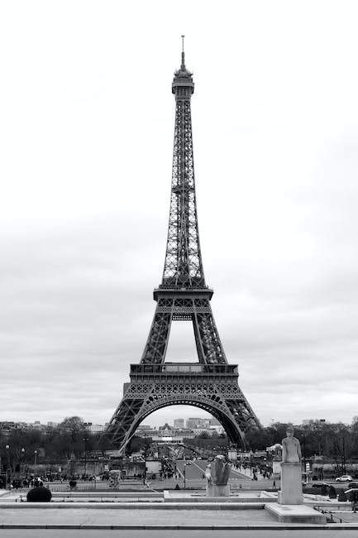
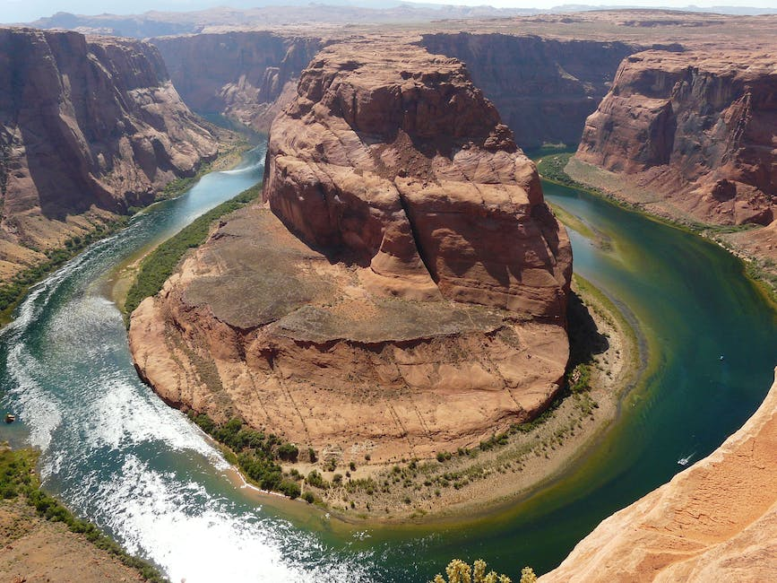
STEP 1: Data Collection (1/2)
I decided to use Pexels API to build the foundations of my datase. Pexels is a website that offers a vast collection of free-high quality photos, videos and illustrations.
I chose this API for 2 main reasons:
Convenience: it enables up to 200 requests per hour enabling me to do some “tests and trials” without being restricted and having to wait another day to pull more data.
Inspiring: since, I’m working on image recognition applied to Travel industry, I wanted to find high-quality and inspiring pictures.

Slide 7
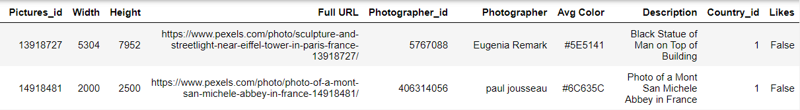
STEP 1: Data Collection (2/2)
Started with a list of most visited countries in the world (~50 counties).
Requested Pexels API to get pictures’ data (80 pictures per country and informative data) and querying with “France travels”, “Spain travels” etc. (iterating through my previous list). I used time.sleep(3) between each iteration of the loop to avoid ban.
Obtained an aggregated JSON files (list of dictionnaries, each picture is a dictionnary) and transformed it into the dataframe below (shape: 3920x10):
Codes Highlights in Appendix.

Slide 8
STEP 2: Data Cleaning
Check for null values but I did not have any.
Since I selected the top 80 pictures (top search results) per country, I could have some duplicated pictures. I decided to remove them using drop_duplicates on Pictures
Anticipating some NLP work later, I decided to standardize all columns containing string by removing special characters and transforming into lower case.
Results: our lugage is less heavy (-238 rows) and “description” and “Photographer” columns are clean.
Codes Highlights in Appendix.

Slide 9
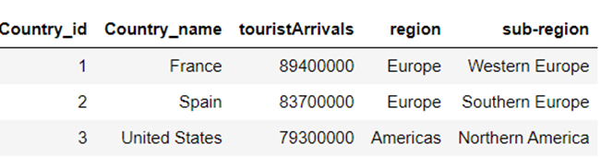
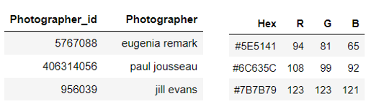

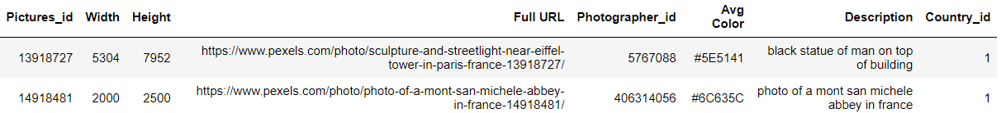
STEP 3: Exporting 4 entities/tables into MySQL (1/2)
After breaking up my main dataframe, I got 4 entities to export in MySQL database:
1. Countries Mapping (shape: 49x5):
3. Photographers Mapping (shape: 1515x2) and
4. Colors Mapping (3618x4):
2. API data (shape: 3682x8):

Slide 10
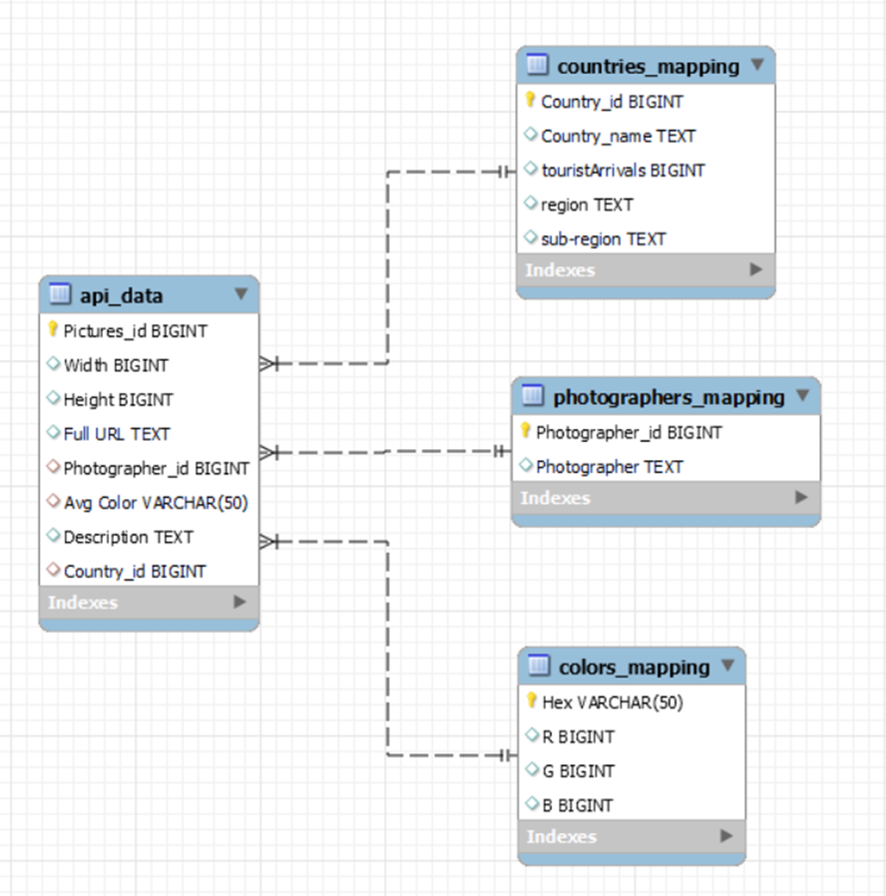

STEP 3: Exporting 4 entities/tables into MySQL (2/2)
After setting Primary/Forein keys, below is my VISA (Entity Relationship Diagram):

Slide 11
02
Getting our VISA
Thanks to SQL and Python, we will begin our Data Exploratory Journey

Slide 12
Generate Insights with SQL and Python Data Analysis capabilities
Photographers and pictures breakdown
Who are they? How do they contribute?
Pictures’ colors
Pictures’ dimension
Any dominant colors?
Are they small, medium large? Any sucessful or preferred format?
Natural Language Processing
Most frequent words used in pictures’ description per country or region

Slide 13
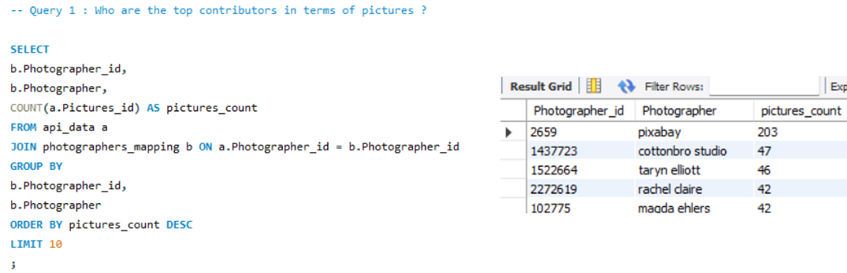
Insight 1: Photographers and pictures breakdown (1/2)
Questions: Who are the top photographers in terms of pictures’ contribution? What is the split between those who published only one picture and those who published 2+? And finally, are they “specialized” in one country or do they tend to publish pictures from several countries?
We can see that pictures could come from several sources such as existing websites (ex: pixabay), professional studio or individuals.

Slide 14
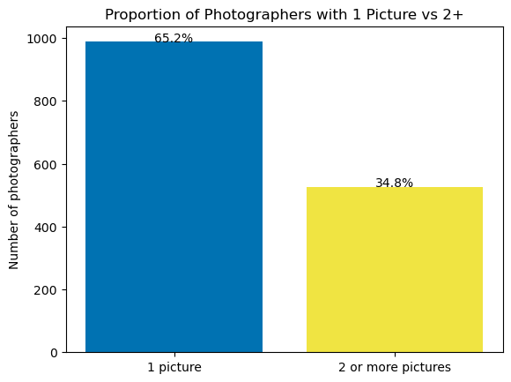
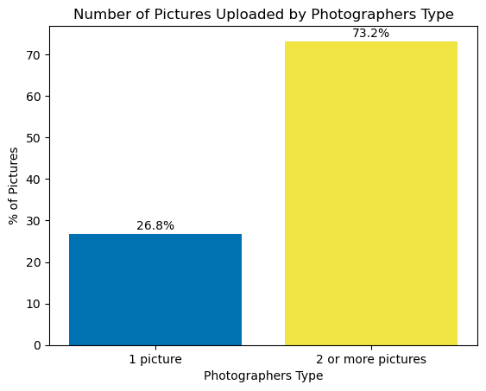
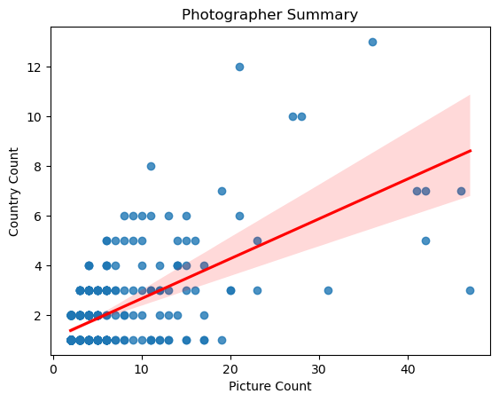
Insight 1: Photographers and pictures breakdown (2/2)
Deep dive and Data Visualization with Python:
Learnings: In our sample, most of the photographers published only one picture. But more than 7 out of 10 of the pictures are published by photographers who published at least 2 pictures. These photographers tend to propose diverse content (covering more than one country).

Slide 15
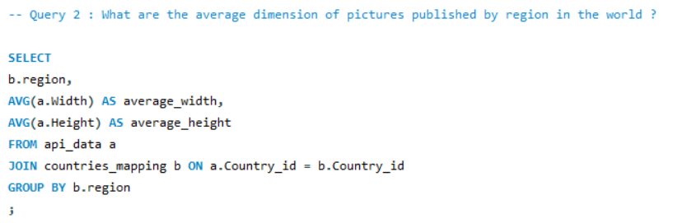
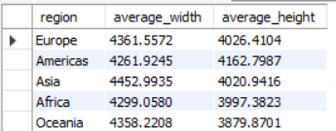
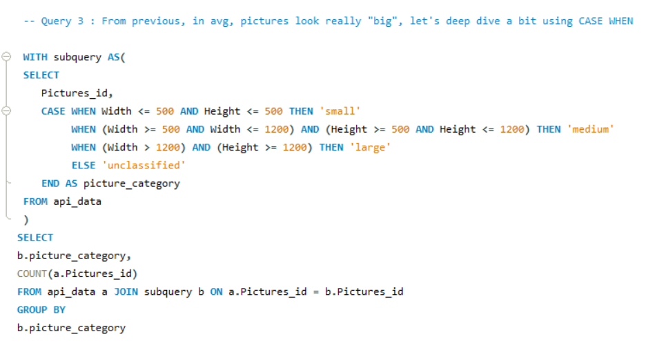
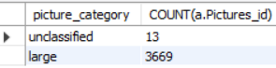
Insight 2: Pictures’ dimension (1/4)
Questions: Do photographers’ upload small, medium or large pictures? Do they have any preferences for landscape or portrait orientation? Let’s ask SQL again!

Slide 16
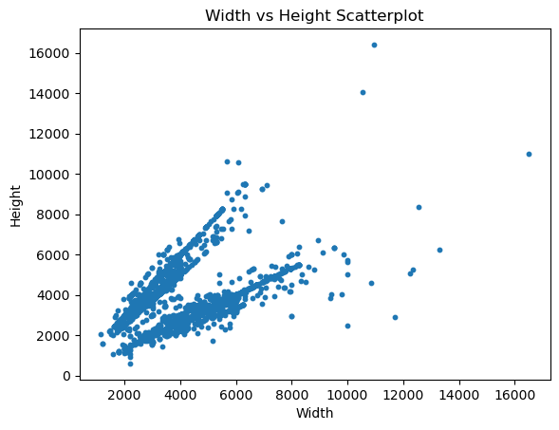
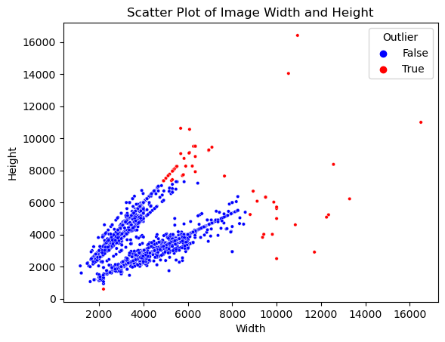
Insight 2: Pictures’ dimension (2/4)
Deep dive and Data Visualization with Python:
Learnings: Scatterplots above confirm our assumption that our dataset mostly contains large pictures (>1200 pixels for width and height). Note: while we don’t exclude outliers in our project, it’s worth mentioning that applying IQR method on both columns, we would have excluded red data points being pictures with too high or low width/height.

Slide 17
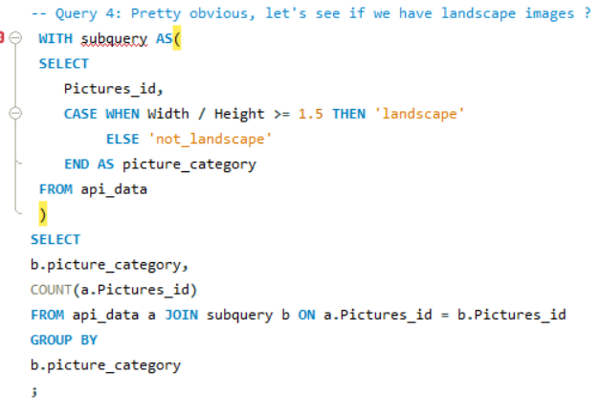
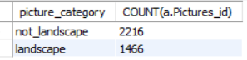
Insight 2: Pictures’ dimension (3/4)
Question: Having a closer look on our previous charts, it looks like we have a “two axis” separation in our data points distribution. Could it be linked to aspect ratio (defined as width/height) meaning we have landscape and portrait orientation as predominant pictures’ format?
It looks like that we had a good intuition on this “two axis” separation. It’s linked to the landscape/portrait orientation (knowing that portrait orientation is defined as aspect ratio >= 1.5).

Slide 18
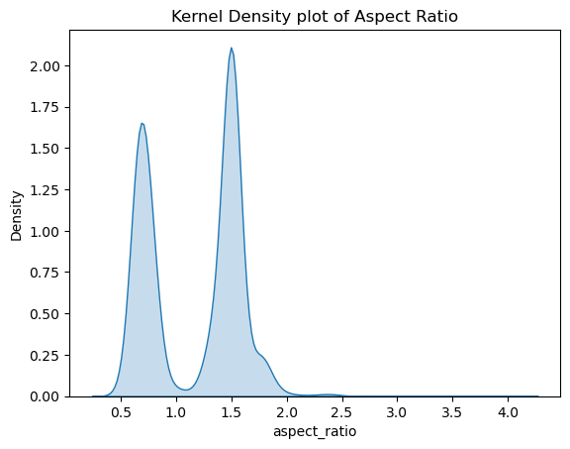
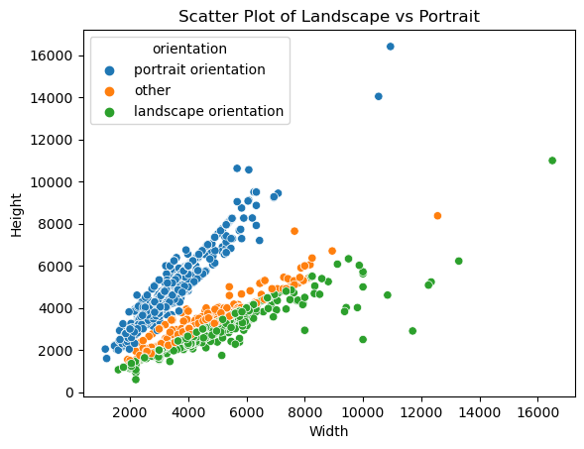
Insight 2: Pictures’ dimension (4/4)
Deep dive and Data Visualization with Python:
Learnings: In this part, we learn that Pexels does comply with its promise of offering free high-quality pictures since most of the pictures of our sample are considered as large. Also, we can see that the most popular orientations in photography (portrait and landscape) are represented in our dataset.

Slide 19
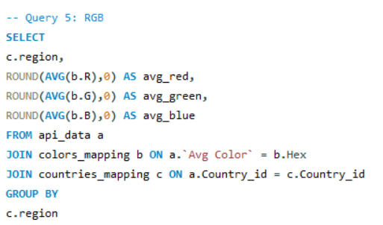
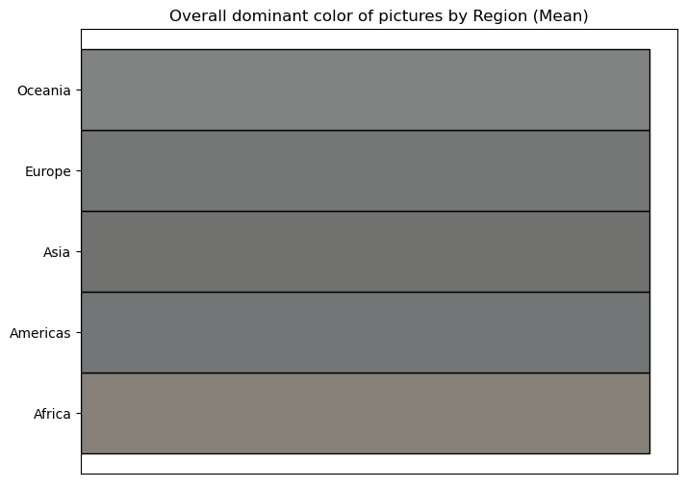
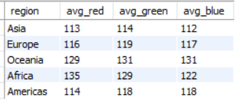
Insight 3: Pictures’ colors (1/2)
Question: Remember about our Hex column (representing the dominant color of the picture according to Pexels API) that I also converted into RGB (Red, Green, Blue) components? Let’s have a further look into this with SQL!
In the query above, I retrieved the average component (RGB) per region. The idea behind is to “plot” these colors so that we can visually see if the colors’ tone are different across regions in the world. But it seems there is an issue using average/mean.

Slide 20
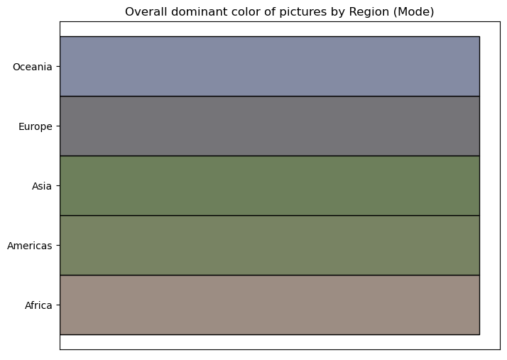
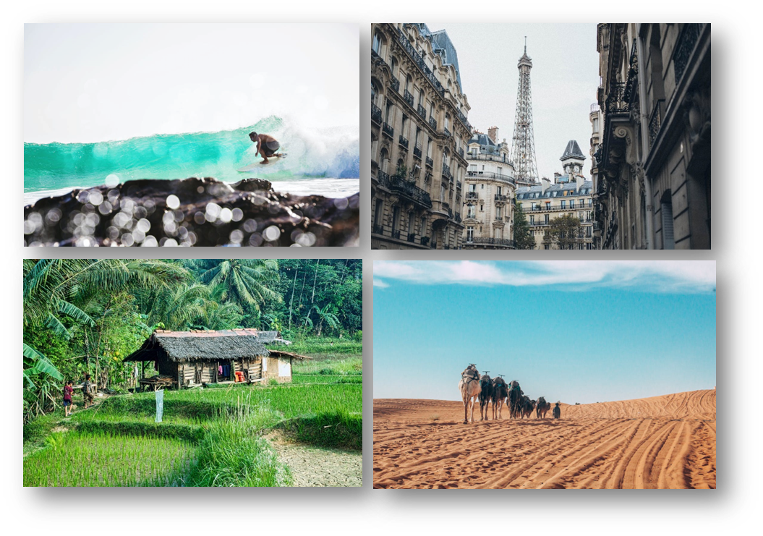
Insight 3: Pictures’ colors (2/2)
Deep dive and Data Visualization with Python:
Learnings: In this part, we learnt that the mode (on RGB) was the most effective way to visualize the most frequent dominant colors’ tone per region. This simple but powerful insights gave us confidence in Pexels API data’s reliability.

Slide 21
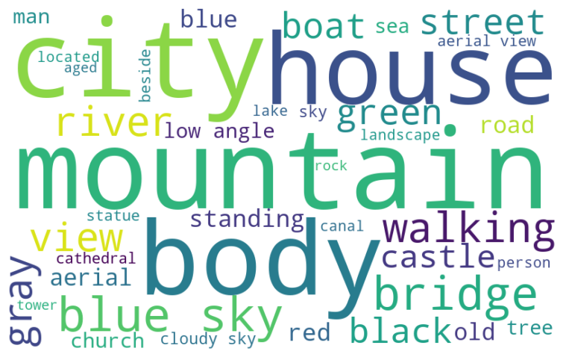
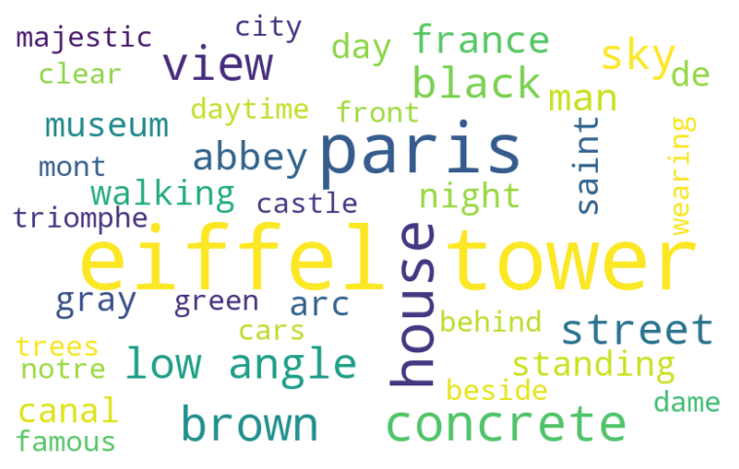
Insight 4: Pictures’ description (NLP)
Question: What are the most frequent words used in pictures’ description? Does it differ from one country to another?
Learnings: In this part, we learnt that the mode (on RGB) was the most effective way to visualize the most frequent dominant colors’ tone per region. This simple but powerful insights gave us confidence in Pexels API data’s reliability.

Slide 22
Insights Summary
XXX
xxx
xxx

Slide 23
03
Travel
Thanks to SQL and Python, we will begin our Data Exploratory Journey

Slide 24
Travel Infographics
$2,000
$4,500
$3,000
Mercury is the closest planet to the Sun and the smallest
Venus is the second planet from the Sun. It’s terribly hot
Jupiter is the biggest planet in the entire Solar System

Slide 25
Travel Infographics
DAYS | Mercury is the closest planet to the Sun
COST | Venus has a beautiful name, but it's hot
CONFORT | It’s the biggest planet in the Solar System
DAYS | Despite being red, Mars is cold
COST | Saturn is the ringed one and a gas giant
CONFORT | Neptune is the farthest planet from the Sun

Slide 26
Travel Infographics
SWIMMING POOL
BEACH
RIVER
Despite being red, Mars is actually a cold place
Venus has a beautiful name and is the second planet
Mercury is the closest planet to the Sun and the smallest one
45%
2019
20%
2019
35%
2019

Slide 27
Travel Infographics
DESTINATION
Mercury is the closest planet to the Sun and the smallest one in the Solar System
PASSPORT
Despite being red, Mars is a cold place. It’s full of iron oxide dust
TICKET
It’s a gas giant and the biggest planet in our Solar System. It’s the fourth-brightest object in the sky

Slide 28
Travel Infographics
1 D
500$
22 D
100$
FLIGHTS
ROAD TRIPS
Mercury is the closest planet to the Sun and the smallest one in the Solar System
It’s a gas giant and the biggest planet in the Solar System. Jupiter is the fourth-brightest object
Venus has a beautiful name
Mercury is the
smallest planet
Mars is a cold place
Jupiter is a gas giant
Neptune is the
farthest planet
Saturn is the
ringed one

Slide 29
Travel Infographics
TRAVEL TO ITALY
1
2
3
4
5
6
7
Venus has a beautiful name and is hot
8
9
10
11
12
13
14
GREECE
Despite being red, Mars is a cold place
15
16
17
18
19
20
21
FREE TIME
22
23
24
25
26
27
28
Mercury is the closest planet to the Sun

Slide 30
Travel Infographics
ITALY
GREECE
FRANCE
Venus has a
beautiful name,
but it’s hot
Neptune is the
farthest planet
from the Sun
Saturn is the
ringed one and a gas giant
BRAZIL
SOUTH KOREA
CHINA
Despite being red, Mars is a cold place
Jupiter is a gas giant and the biggest planet
Mercury is the
closest planet to the Sun
100%
90%
80%
100%
80%
40%

Slide 31
Travel Infographics
PARIS
NEW YORK
KATHMANDU
AGRA
HANGZHOU
Venus has a beautiful name and is hot
Mercury is the
closest planet to the Sun
Despite being red, Mars is a cold place
Jupiter is a gas giant and the biggest planet
Neptune is the farthest planet from the Sun

Slide 32
Travel Infographics
 | SUITCASES | TICKET | PASSPORT
BUS
PLANE
TRAIN
SHIP

Slide 33
Travel Infographics
45%
65%
Despite being red, Mars is actually cold
Mercury is the closest planet to the Sun
25%
85%
Jupiter is a gas giant and the biggest planet
Venus is the second planet from the Sun

Slide 34
Travel Infographics
AMERICAS
AUSTRALIA
Venus is the second planet from the Sun
It’s the biggest planet in the Solar System
35%
56%

Slide 35
Travel Infographics
WHAT
COUNTRY?
ITALY
GREECE
FRANCE
GERMANY
Mercury is the
closest planet to the Sun
Despite being red, Mars is a cold place
Jupiter is a gas giant and the biggest planet
Neptune is the farthest planet from the Sun

Slide 36
Travel Infographics
THRIFT
Mercury is the closest planet to the Sun
PLACES
Venus has a beautiful name, but also high temperatures
TOURISM
Jupiter is a gas giant and the biggest planet
TRAVEL
Despite being red, Mars is actually a cold place

Slide 37
Travel Infographics
ITALY
FRANCE
BELGIUM
Mercury is the closest planet to the Sun
Venus is the second planet from the Sun
Jupiter is a gas giant and the biggest planet
2016
2018
2019
2015
2017
2018
2020
CHINA
SOUTH KOREA
JAPAN
BRAZIL
Despite being red, Mars is a cold place
Earth is the planet where we live on
Neptune is the farthest planet from the Sun
Saturn is a gas giant and has several rings

Slide 38
Travel Infographics
50%
60%
85%
97%
SPRING
SUMMER
FALL
WINTER
Mercury is the closest planet to the Sun
Venus has a beautiful name and is hot
Despite being red, Mars is cold
Jupiter is a gas giant and the biggest planet

Slide 39
Travel Infographics
1
2
3
TRAVEL
CITY
PLACES
Mercury is the closest planet to the Sun and smallest one
Venus has a beautiful name and is the second planet
Despite being red, Mars is actually a really cold place

Slide 40
Travel Infographics
BEACH
MOUNTAIN
CITY
Mercury is the closest planet to the Sun
Venus has a beautiful name and is hot
Despite being red, Mars is actually cold
2
1
3

Slide 41
Travel Infographics
CITIE
1
3
RESTAURANTS
Mercury is the closest planet to the Sun
It’s a gas giant and the
biggest planet
MUSEUMS
2
4
MONUMENTS
Venus has a beautiful name and is hot
Despite being red, Mars is a really cold place

Slide 42
Travel Infographics
SUMMER
10%
30%
SPRING
Venus has a beautiful name and is the second planet
Neptune is the fourth-largest planet in the Solar System
25%
35%
WINTER
FALL
Mercury is the closest planet to the Sun and smallest one
Jupiter is the biggest planet in the entire Solar System

Slide 43
Travel Infographics
25%
45%
65%
TRAVEL BY SEA
TOURISM
GUIDE
It’s a gas giant and the biggest planet in the Solar System. Jupiter is the fourth-brightest
Mercury is the closest planet to the Sun and the smallest one in the Solar System
Venus has a beautiful name and is the second planet from the Sun. It’s terribly hot

Slide 44
Travel Infographics
65%
45%
CHINA
POLAND
Venus has a beautiful name and is the second planet
Despite being red, Mars is actually a really cold place
25%
32%
ANGOLA
TANZANIA
Mercury is the closest planet to the Sun and smallest one
Neptune is the fourth-largest planet in the Solar System

Slide 45
Travel Infographics
DATE
PLACE
REQUIREMENTS
Despite being red, Mars is actually a cold place
Venus has a beautiful name and is the second
Mercury is the closest planet to the Sun

Slide 46
Travel Infographics
CHINA
JAPAN
It’s the second-brightest natural object in the night
sky after the Moon
SEPTEMBER
Saturn is composed mostly of hydrogen and also helium
SUN
MON
TUE
WEN
THU
FRI
SAT
1
2
3
4
5
6
7
8
9
10
11
12
13
14
15
16
17
18
19
SOUTH KOREA
BRAZIL
Mercury is the closest planet to the Sun and the smallest one
20
21
22
23
24
25
26
Neptune is the fourth-largest planet in the Solar System
27
28
29
30
31

Slide 47
Travel Infographics
TRAVELLERS
PRICE
CONFORT
Mercury is the closest planet to the Sun and smallest one
45%
$25
60%
Despite being red, Mars is actually a cold place
30%
$40
60%
Saturn is composed mostly of hydrogen and helium
25%
$15
60%

Slide 48
Travel Infographics
UK
GREECE
AUSTRALIA
ITALY
Venus is the second planet from the Sun
Mercury is the closest planet to the Sun
Jupiter is a gas giant and the biggest one
Saturn is a gas giant and has several rings

Slide 49
Travel Infographics
Mercury is the smallest planet
BRAZIL
ITALY
Mercury is the smallest planet
Despite being red, Mars is cold
AUSTRIA
FRANCE
Despite being red, Mars is cold
It’s a gas giant and the biggest
VIETNAM
BELGIUM
It’s a gas giant and the biggest
Venus has a beautiful name
GERMANY
EGYPT
Venus has a beautiful name

